Slide 1
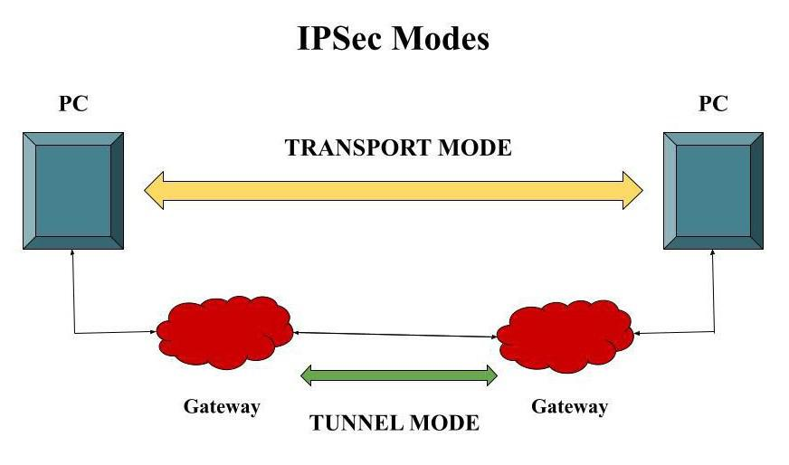
BCSE309L - Cryptography and Network Security
Module 6 - IP Security

Slide 2
IP Security
By implementing security at the IP level, an organization can ensure secure networking not only for applications that have security mechanisms but also for the many security-ignorant applications
IP-level security encompasses three functional areas:
The authentication mechanism assures that a received packet was, in fact, transmitted by the party identified as the source in the packet header. In addition, this mechanism assures that the packet has not been altered in transit
The confidentiality facility enables communicating nodes to encrypt messages to prevent eavesdropping by third parties
The key management facility is concerned with the secure exchange of keys

Slide 3
IP Security Overview
Need for IP Security
To secure the network infrastructure from unauthorized monitoring
To control of network traffic
To secure end-user-to-end-user traffic using authentication and encryption mechanisms
Applications of IPsec
Secure branch office connectivity over the Internet
Secure remote access over the Internet
Establishing extranet and intranet connectivity with partners
Enhancing electronic commerce security

Slide 4
IPsec Services
IPsec provides security services at the IP layer by enabling a system to select required security protocols, determine the algorithm(s) to use for the service(s), and put in place any cryptographic keys required to provide the requested services
Two protocols are used to provide security:
An authentication protocol designated by the header of the protocol, Authentication Header (AH)
A combined encryption/authentication protocol designated by the format of the packet for that protocol, Encapsulating Security Payload (ESP)
Lists of services:
Access control
Connectionless integrity
Data origin authentication
Rejection of replayed packets (a form of partial sequence integrity)
Confidentiality (encryption)
Limited traffic flow confidentiality

Slide 5
IP Security Policy
Fundamental to the operation of IPsec is the concept of a security policy applied to each IP packet that transits from a source to a destination
IPsec policy is determined primarily by the interaction of two databases
The Security Association Database (SAD)
The Security Policy Database (SPD)

Slide 6
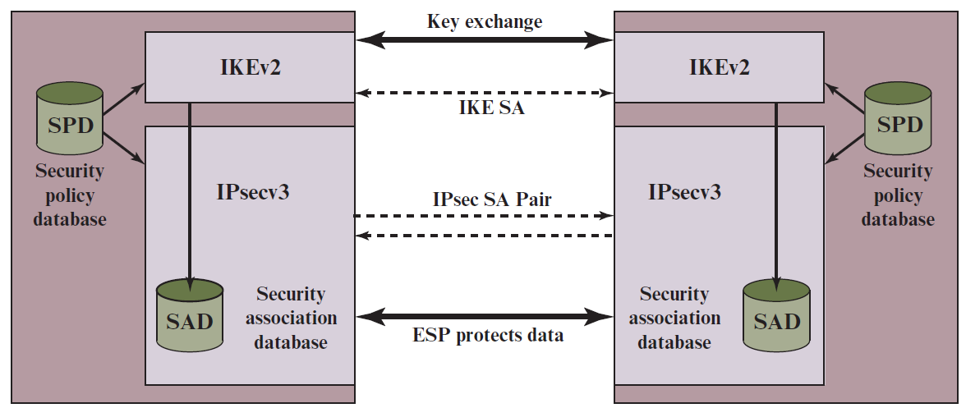
IPsec Architecture

Slide 7
Security Associations (SA)
A key concept that appears in both the authentication and confidentiality mechanisms for IP
An association is a one-way logical connection between a sender and a receiver that affords security services to the traffic carried on it
A security association is uniquely identified by three parameters
Security Parameters Index (SPI): A 32-bit unsigned integer assigned to this SA and having local significance only. The SPI is carried in AH and ESP headers to enable the receiving system to select the SA under which a received packet will be processed
IP Destination Address: This is the address of the destination endpoint of the SA, which may be an end-user system or a network system such as a firewall or router
Security Protocol Identifier: This field from the outer IP header indicates whether the association is an AH or ESP security association

Slide 8
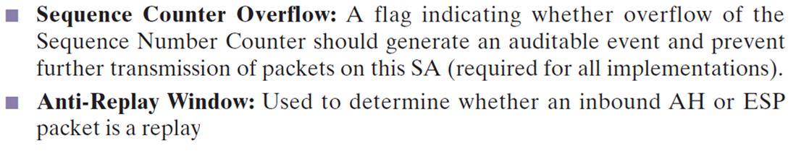
Security Association Database (SAD)
Defines the parameters associated with each SA
Parameters:
Security Parameter Index: A 32-bit value selected by the receiving end of an SA to uniquely identify the SA
Sequence Number Counter: A 32-bit value used to generate the Sequence Number field in AH or ESP headers

Slide 9
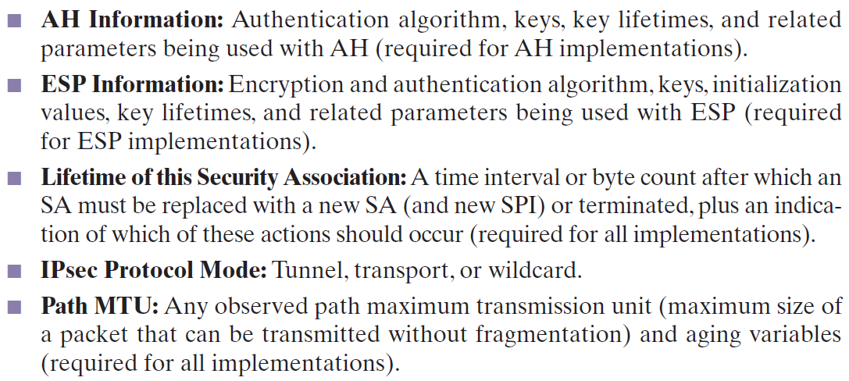
Cont…

Slide 10
Cont…
The key management mechanism that is used to distribute keys is coupled to the authentication and privacy mechanisms only by way of the Security Parameters Index (SPI)
Authentication and privacy have been specified independent of any specific key management mechanism

Slide 11
Security Policy Database
The means by which IP traffic is related to specific SAs
Contains entries, each of which defines a subset of IP traffic and points to an SA for that traffic
Each SPD entry is defined by a set of IP and upper-layer protocol field values - Selectors
Used to filter outgoing traffic in order to map it into a particular SA
Outbound processing obeys the following general sequence for each IP packet
Compare the values of the appropriate fields in the packet (the selector fields) against the SPD to find a matching SPD entry, which will point to zero or more SAs
Determine the SA if any for this packet and its associated SPI
Do the required IPsec processing (i.e., AH or ESP processing)

Slide 12
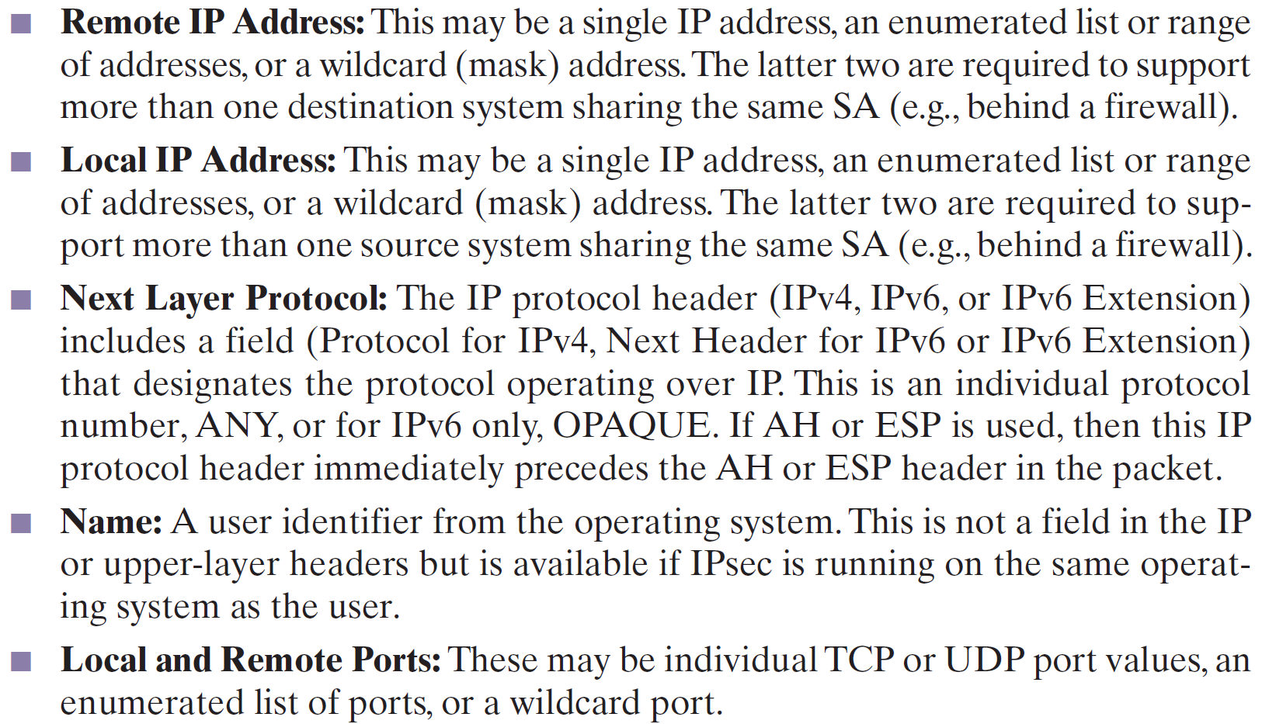
Selectors (Determine an SPD entry)

Slide 13
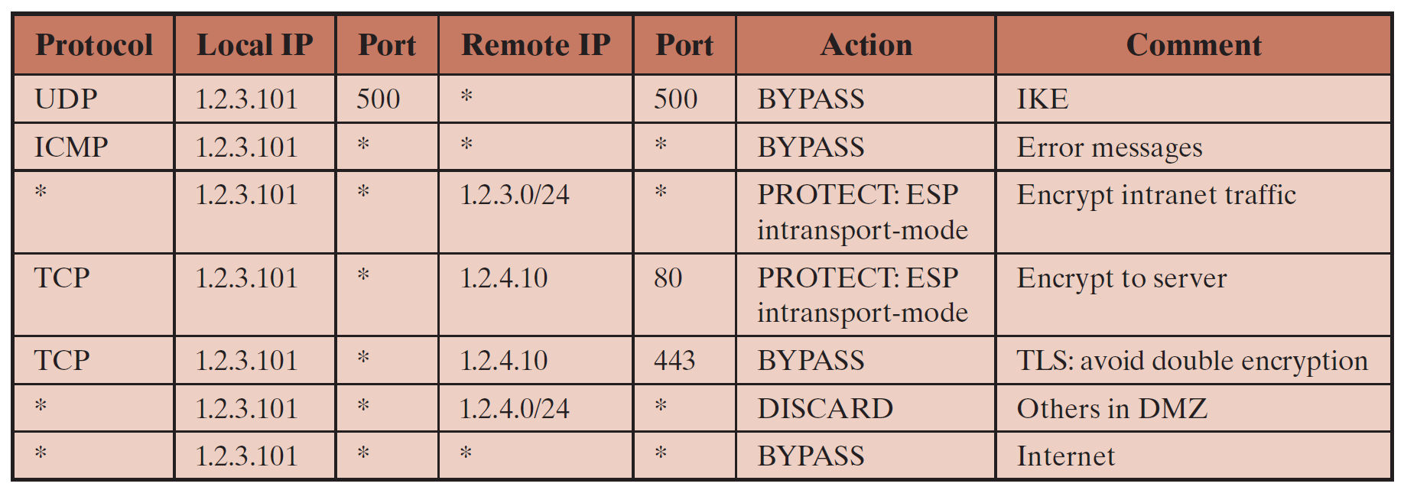
Host SPD Example
Example: UDP port 500 is the designated port for IKE. Any traffic from the local host to a remote host for purposes of an IKE exchange bypasses the IPsec processing

Slide 14
IP Traffic Processing
IPsec is executed on a packet-by-packet basis
When IPsec is implemented,
Each outbound IP packet is processed by the IPsec logic before transmission
Each inbound packet is processed by the IPsec logic after reception and before passing the packet contents on to the next higher layer (e.g., TCP or UDP)

Slide 15
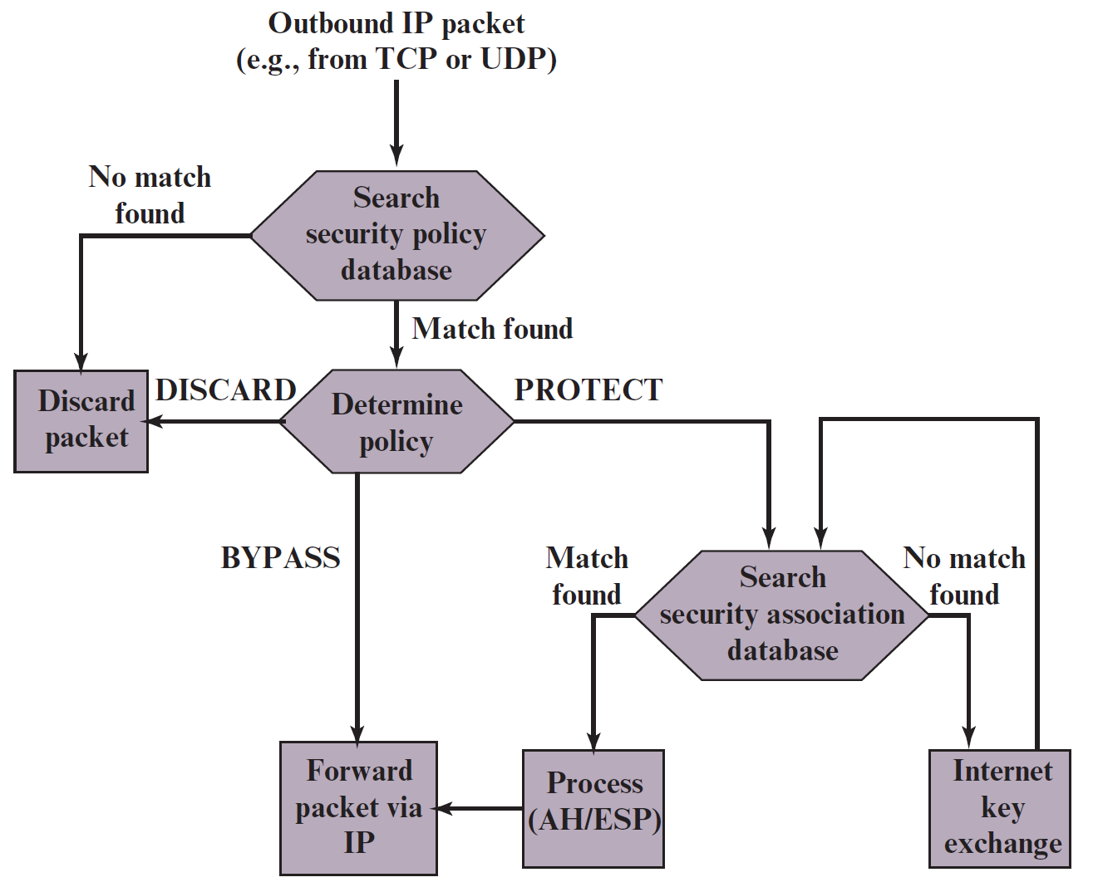
Processing Model for Outbound Packets

Slide 16
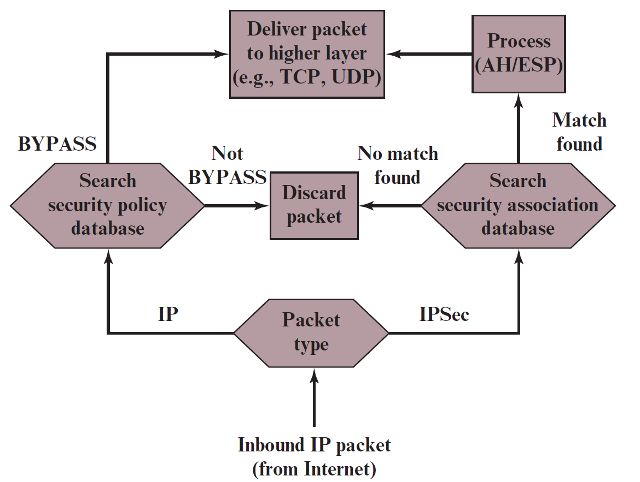
Processing Model for Inbound Packets

Slide 17
Encapsulating Security Payload [ESP]
ESP can be used to provide confidentiality, data origin authentication, connectionless integrity, an anti-replay service (a form of partial sequence integrity), and (limited) traffic flow confidentiality
The set of services provided depends on options selected at the time of Security Association (SA) establishment and on the location of the implementation in a network topology
ESP can work with a variety of encryption and authentication algorithms

Slide 18
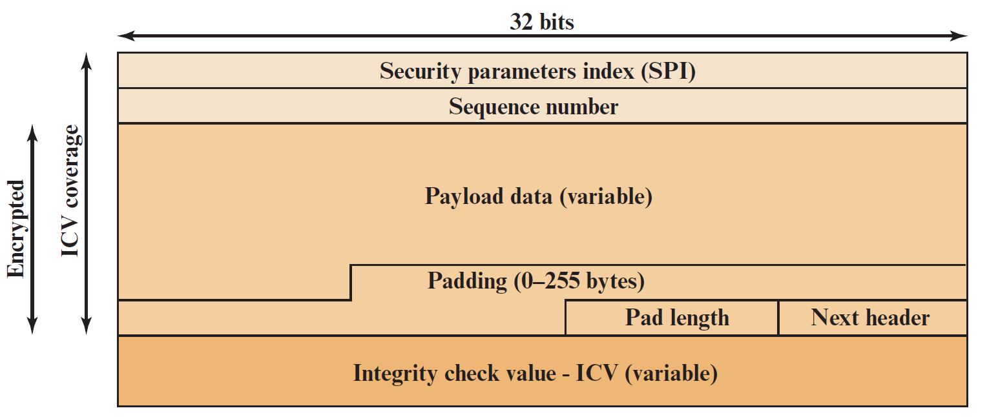
ESP Format

Slide 19
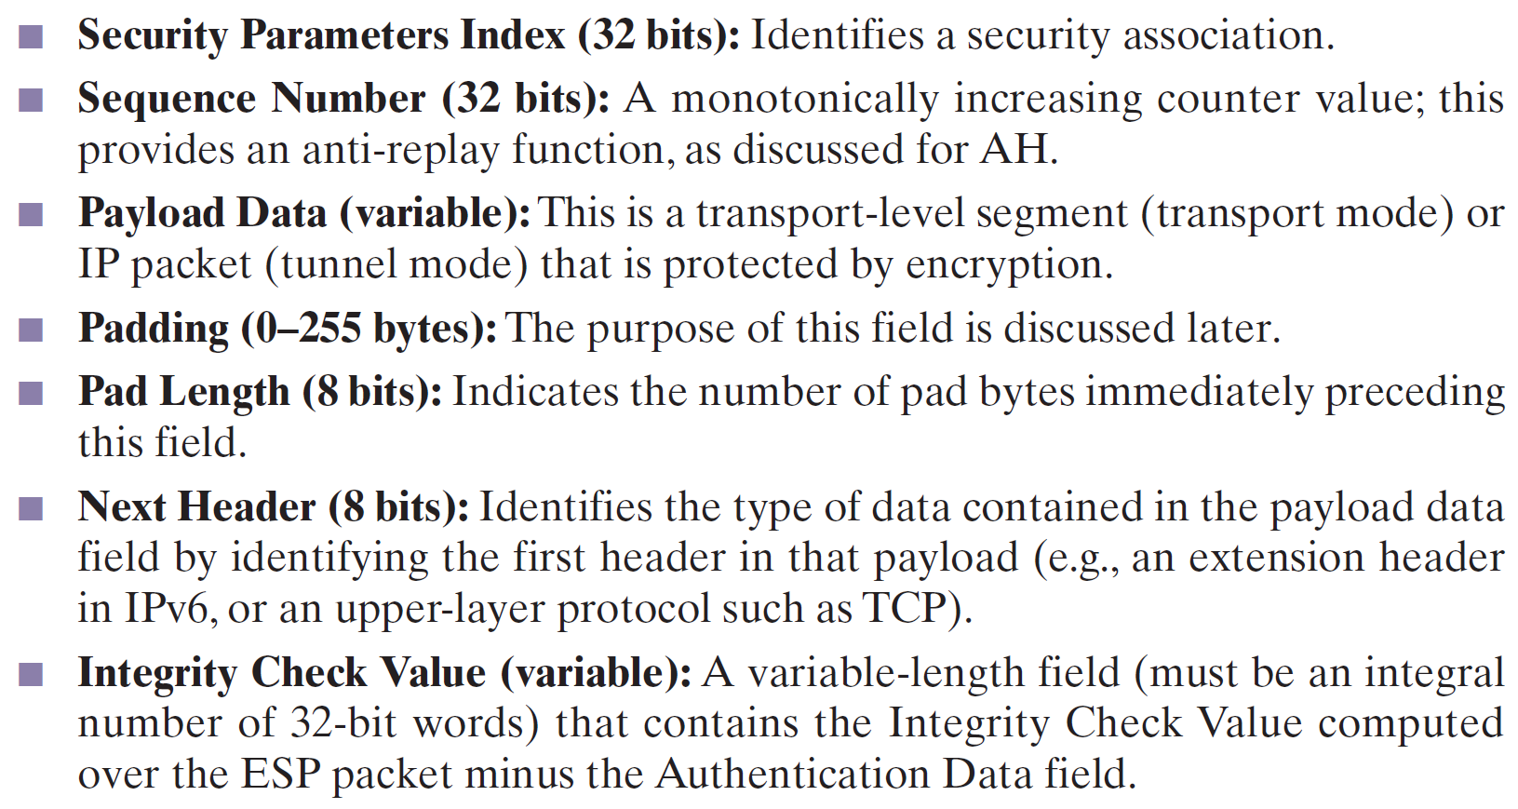
ESP packet fields

Slide 20
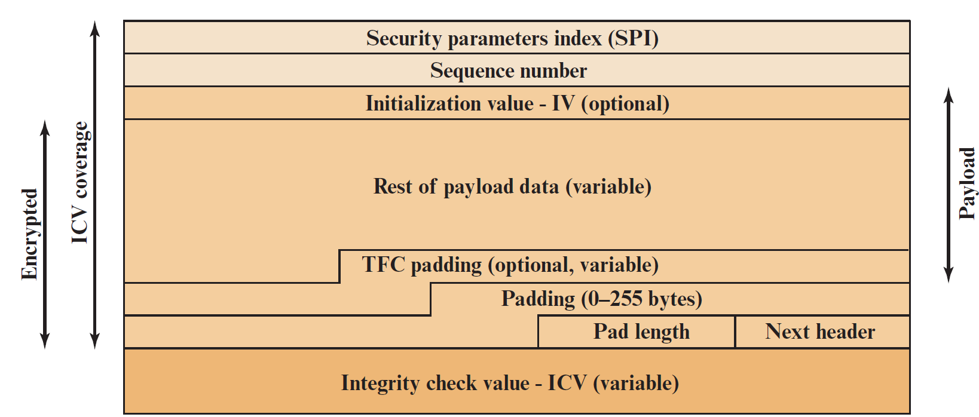
Substructure of Payload Data
An Initialization Value (IV), or nonce, is present if this is required by the encryption or authenticated encryption algorithm used for ESP
If tunnel mode is being used, then the IPsec implementation may add Traffic Flow Confidentiality (TFC) padding after the Payload Data and before the Padding field

Slide 21
Encryption and Authentication Algorithms
The Payload Data, Padding, Pad Length, and Next Header fields are encrypted by the ESP service
If the algorithm used to encrypt the payload requires cryptographic synchronization data, such as an Initialization Vector (IV), then these data may be carried explicitly at the beginning of the Payload Data field
If included, an IV is usually not encrypted, although it is often referred to as being part of the ciphertext
The ICV field is optional. It is present only if the integrity service is selected and is provided by either a separate integrity algorithm or a combined mode algorithm that uses an ICV
Allows for the possibility of parallel processing of packets at the receiver that is decryption can take place in parallel with integrity checking

Slide 22
Purpose of padding
If an encryption algorithm requires the plaintext to be a multiple of some number of bytes (e.g., the multiple of a single block for a block cipher), the Padding field is used to expand the plaintext (consisting of the Payload Data, Padding, Pad Length, and Next Header fields) to the required length
The ESP format requires that the Pad Length and Next Header fields be right aligned within a 32-bit word.
Equivalently, the ciphertext must be an integer multiple of 32 bits. The Padding field is used to assure this alignment
Additional padding may be added to provide partial traffic-flow confidentiality by concealing the actual length of the payload

Slide 23
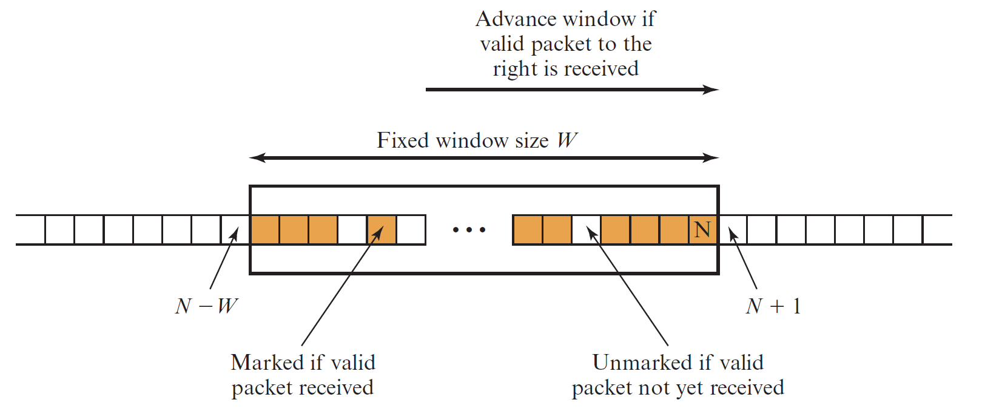
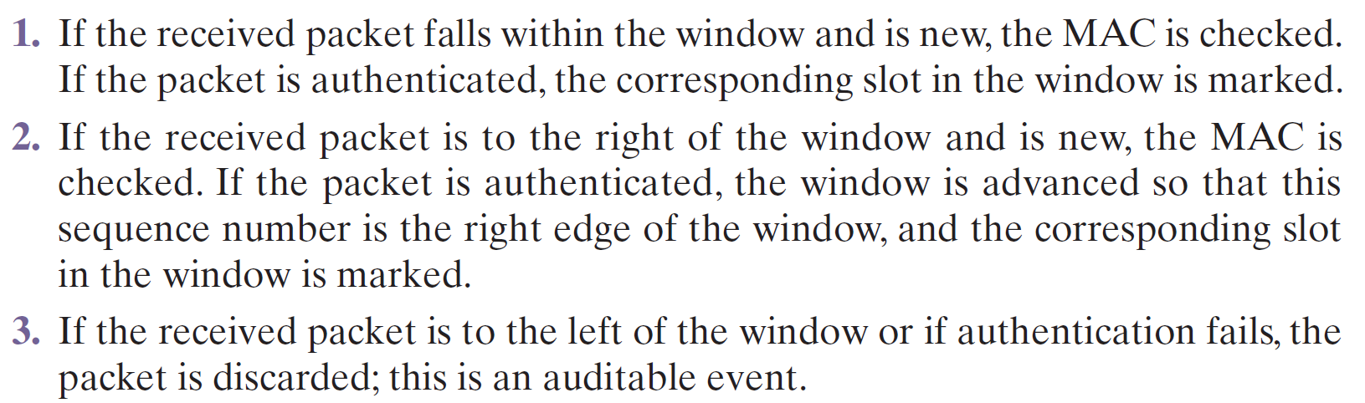
Anti-Replay Mechanism

Slide 24
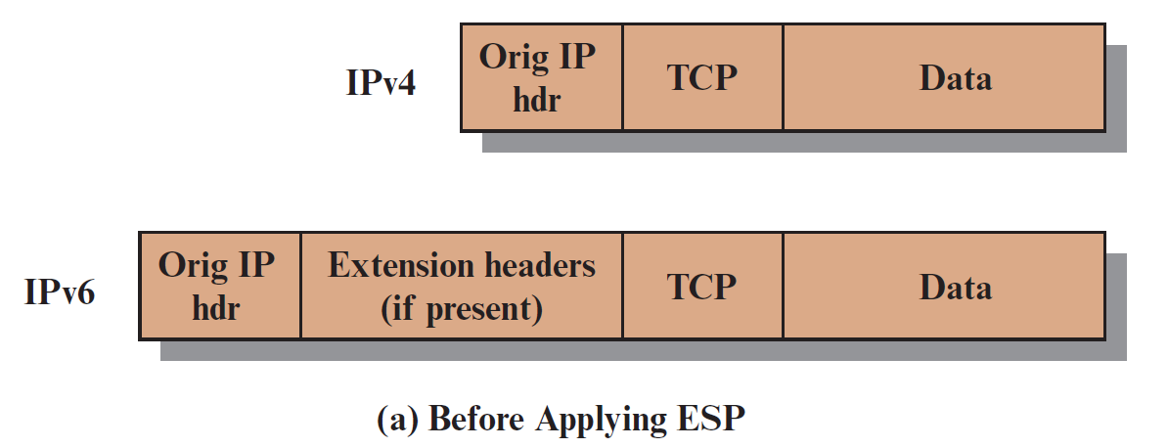
Transport and Tunnel Modes
Both AH and ESP support two modes of use: transport and tunnel mode
Transport mode - provides protection primarily for upper-layer protocols
Tunnel mode - provides protection to the entire IP packet

Slide 25
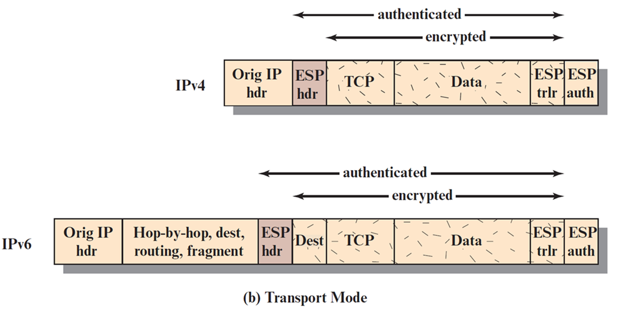
Transport Mode ESP
Transport mode provides protection primarily for upper-layer protocols
That is, transport mode protection extends to the payload of an IP packet

Slide 26
Transport Mode ESP Operations
At the source, the block of data consisting of the ESP trailer plus the entire transport-layer segment is encrypted and the plaintext of this block is replaced with its ciphertext to form the IP packet for transmission. Authentication is added if this option is selected
The packet is then routed to the destination. Each intermediate router needs to examine and process the IP header plus any plaintext IP extension headers but does not need to examine the ciphertext
The destination node examines and processes the IP header plus any plaintext IP extension headers. Then, on the basis of the SPI in the ESP header, the destination node decrypts the remainder of the packet to recover the plaintext transport-layer segment

Slide 27
Tunnel Mode ESP
Tunnel mode provides protection to the entire IP packet
To achieve this, after the AH or ESP fields are added to the IP packet, the entire packet plus security fields is treated as the payload of new outer IP packet with a new outer IP header
The entire original, inner, packet travels through a tunnel from one point of an IP network to another; no routers along the way are able to examine the inner IP header
Because the original packet is encapsulated, the new, larger packet may have totally different source and destination addresses, adding to the security
Tunnel mode is used when one or both ends of a Security Association (SA) are a security gateway, such as a firewall or router that implements IPsec

Slide 28
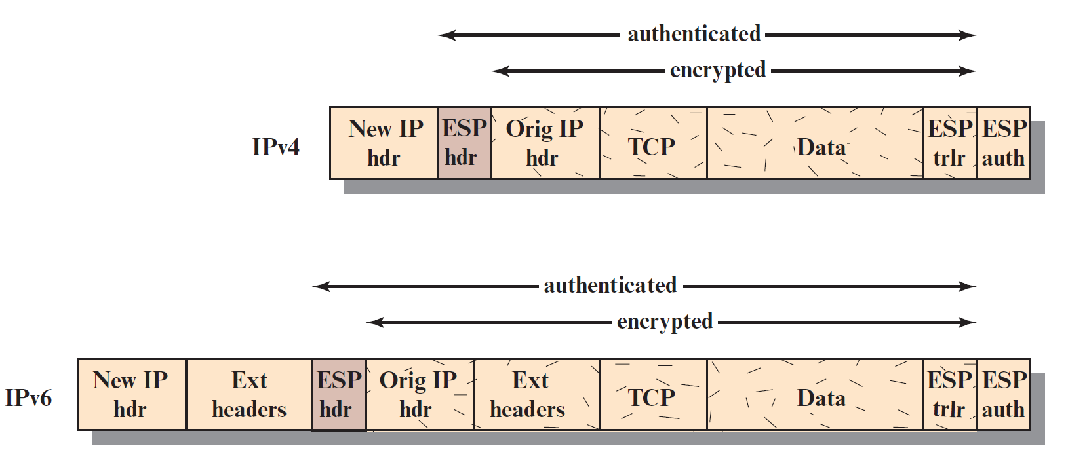
Cont…

Slide 29
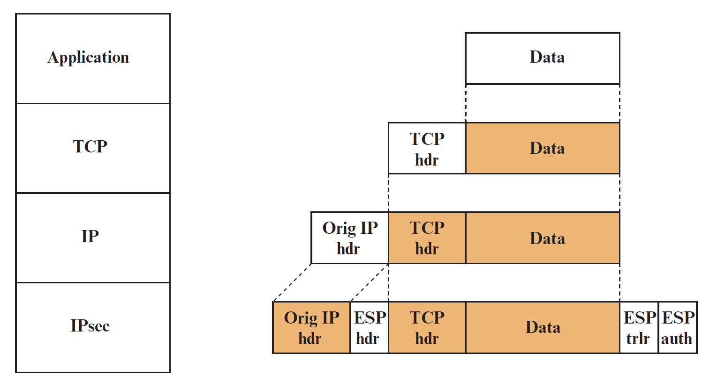
Protocol Operation for ESP: Transport mode

Slide 30
Virtual Private Network (VPN)
Tunnel mode can be used to implement a secure virtual private network
A Virtual Private Network (VPN) is a private network that is configured within a public network (a carrier’s network or the Internet) in order to take advantage of the economies of scale and management facilities of large networks
VPNs are widely used by enterprises to create wide area networks that span large geographic areas, to provide site-to-site connections to branch offices, and to allow mobile users to dial up their company LANs
From the point of view of the provider, the pubic network facility is shared by many customers, with the traffic of each customer segregated from other traffic
Traffic designated as VPN traffic can only go from a VPN source to a destination in the same VPN
It is often the case that encryption and authentication facilities are provided for the VPN

Slide 31
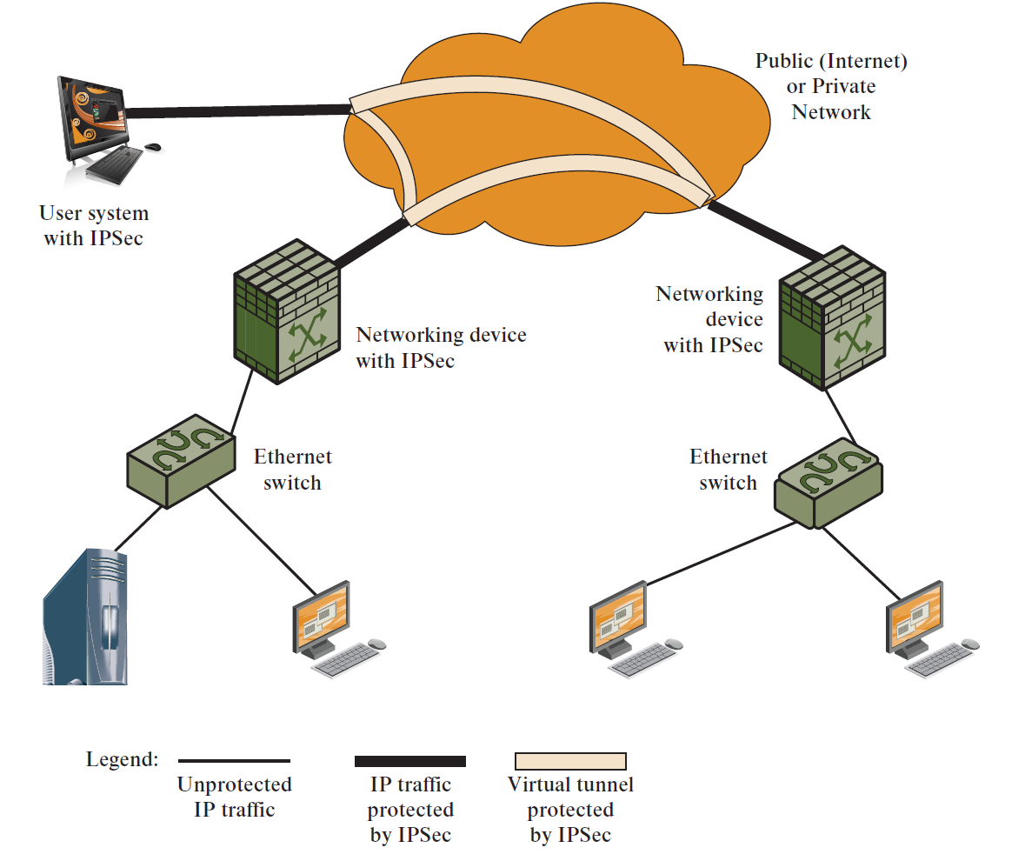
Example of Virtual Private Network Implemented with IPsec Tunnel Mode

Slide 32
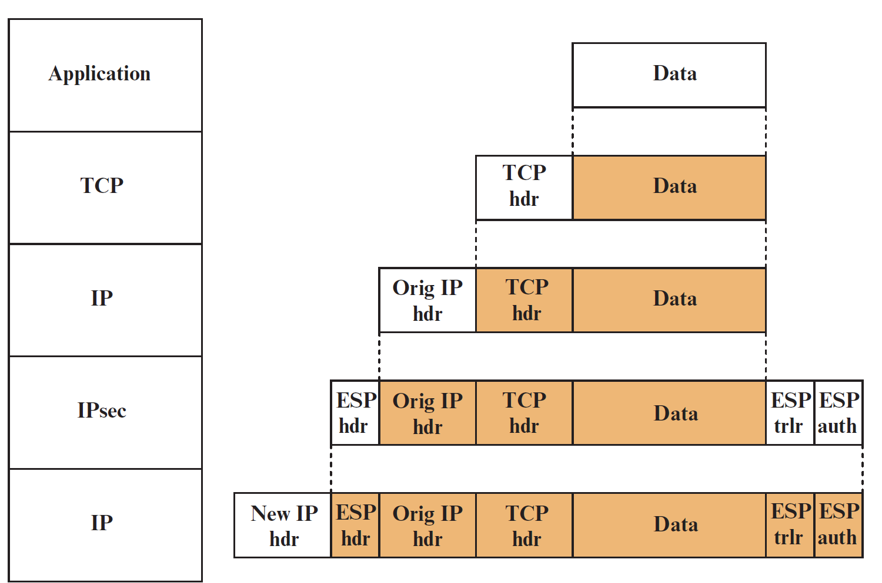
Protocol Operation for ESP: Tunnel mode

Slide 33
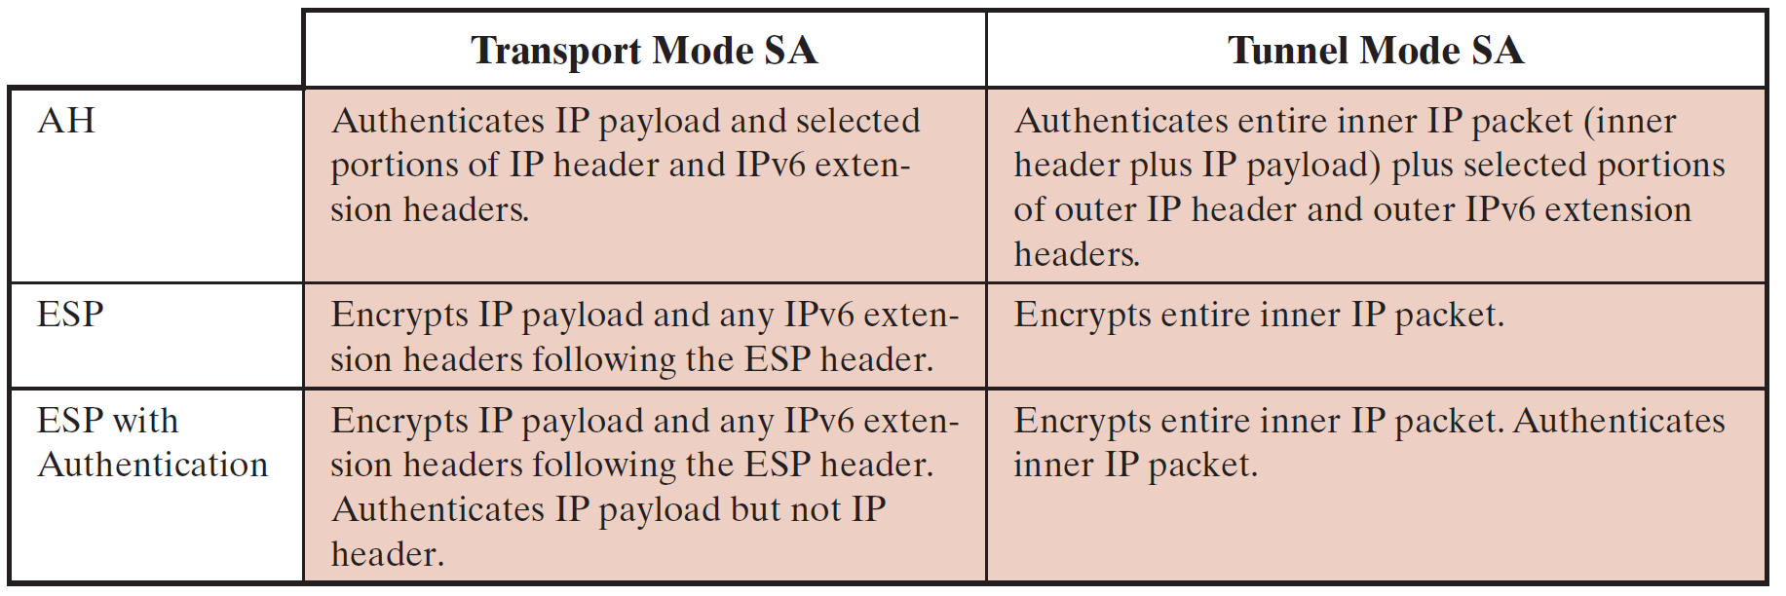
Tunnel Mode and Transport Mode Functionality

